Slide 1

Gender and age prediction: image classification using cnn
A DEEP LEARNING APPROACH
SUBMITTED TO :
MS VAISHALI KUMAR
PROJECT GUIDE :
MRS. HETAL THAKER
SUBMITTED BY:
NISHITA BAJAJ
20230804021

Slide 2
AGENDA
Introduction
Objective
Convolutional neural network
Data
Model architecture
Model training
Model evaluation
Result & Visualization
Conclusion
References

Slide 3
introduction
Brief Overview of Gender and Age Prediction
Gender and age prediction involves using machine learning models, particularly Convolutional Neural Networks (CNNs), to determine an individual's gender and estimate their age from facial images. This technology leverages patterns and features extracted from images to make accurate predictions.
Applications:
Personalization of content and advertisements.
Enhancing user interaction and experience.
Analyzing population trends and behaviors.
Gathering data for public policy and economic planning.
Delivering ads tailored to specific age groups and genders.
Improving marketing campaign efficiency.
Increasing user engagement and conversion rates.

Slide 4
O b j e c t I v e
Develop a CNN Model
Objective: Build and train a Convolutional Neural Network (CNN) capable of predicting gender and estimating age from facial images.
Approach: Utilize a well-curated dataset to train the CNN, implementing state-of-the-art techniques in deep learning to optimize performance.
Evaluate Model’s Accuracy and Efficiency
Accuracy: Measure how correctly the model predicts gender and estimates age. Utilize metrics like accuracy for gender classification and Mean Absolute Error (MAE) for age estimation.
Efficiency: Assess the model's computational performance, including training time, inference speed, and resource usage.

Slide 5
Convolutional neural network
CNNs are a class of deep learning models primarily used for analyzing visual data. They are particularly effective in image recognition and classification tasks due to their ability to automatically and adaptively learn spatial hierarchies of features.
Key Components:
Convolutional layer
Pooling layer
Fully connected layer
Activation Function
Dropout Layer

Slide 6
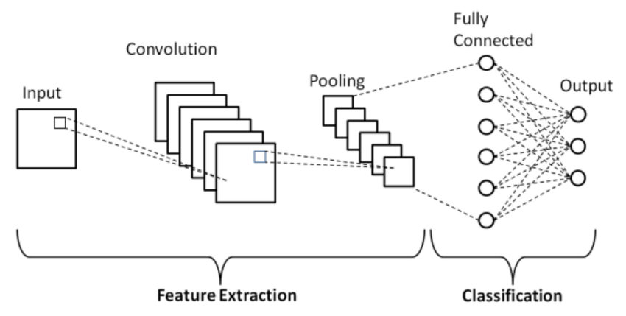

Slide 7
Dataset
Description of the Dataset:
The dataset used for this project is created in custom manner. It contains facial images labeled with gender and age, providing a diverse range of real-world examples for training and evaluating the CNN model.
Images are taken from various sources, including social media and public datasets, ensuring a wide representation of different age groups.
Distribution of Gender and Age:
Gender Distribution:
The dataset is roughly balanced with approximately 50% male and 50% female images, ensuring that the model does not become biased towards one gender.
Age Distribution:
The age labels range from 1 to 95 years, providing a comprehensive spectrum for age prediction.

Slide 8
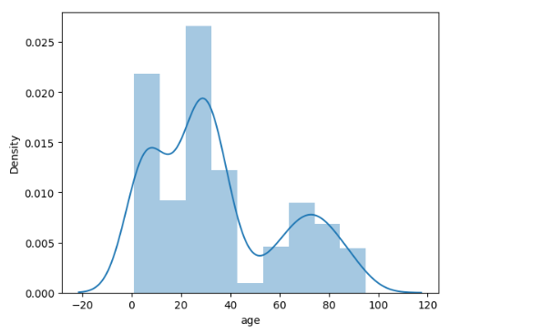
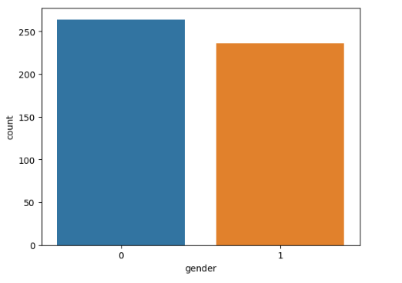

Slide 9
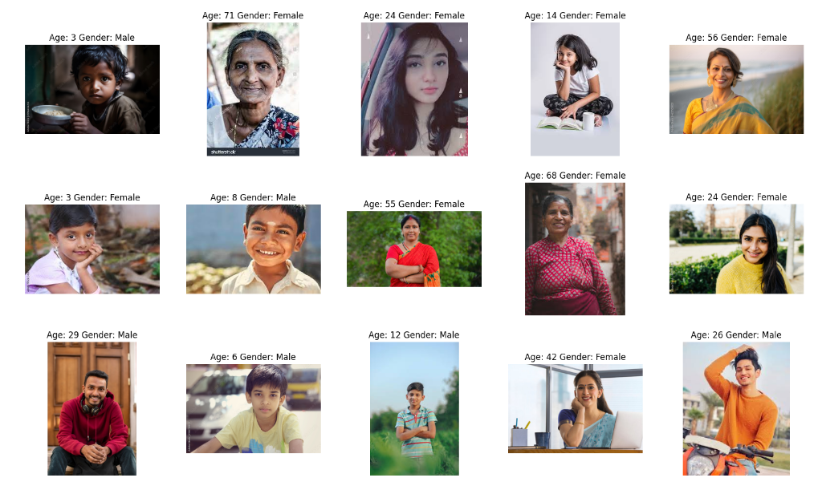

Slide 10
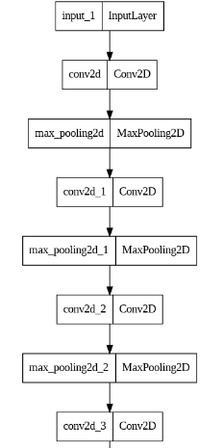
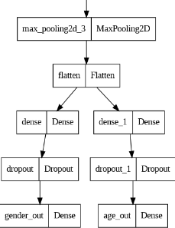
Model architecture
Model 1: Base Model
Convolutional layer [32, 64, 128, 256]
Kernel size [3 x 3]
Max - Pooling layer[2 x 2]
Flatten layer
Fully connected[256, 256]
Dropout layer[0.3]
Activation function[ReLU, Linear, sigmoid]
Evaluation function[“Binary cross entropy”, “MAE”]
Optimizer [Adam]
Accuracy Metrics

Slide 11
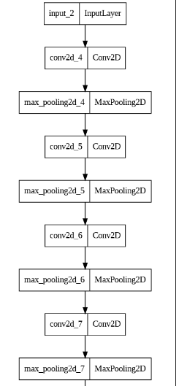
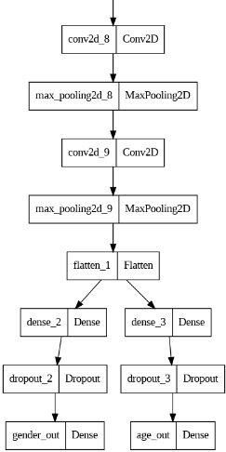
Model architecture
Model 2: Increase layers
Convolutional layer [16, 32, 64, 128, 256, 512]
Kernel size [3 x 3]
Max - Pooling layer [2 x 2]
Flatten layer
Fully connected layer[512, 512]
Dropout layer[0.3]
Activation layer[ReLU, sigmoid]
Evaluation function[“Binary cross entropy”, “MAE”]
Optimizer [Adam]
Accuracy Metrics

Slide 12
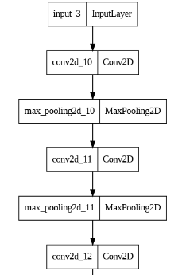
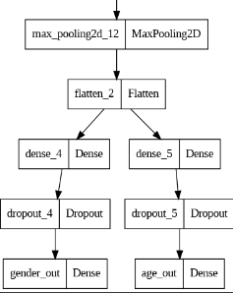
Model architecture
Model 3: Decrease layers
Convolutional layer [16, 32, 64]
Kernel size [3 x 3]
Max - Pooling layer[2 x 2]
Flatten layer
Fully connected layer[256,256]
Dropout layer[0.3]
Activation function[ReLU, sigmoid]
Evaluation function[“Binary cross entropy”, “MAE”]
Optimizer [Adam]
Accuracy Metrics

Slide 13
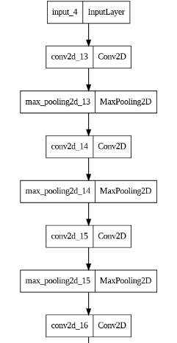
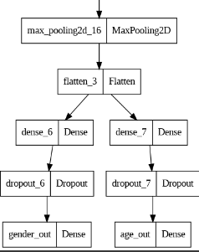
Model architecture
Model 4: Add learning rate
Convolutional layer [16, 32, 64, 128]
Kernel size [3 x 3]
Max - Pooling layer[2 x 2]
Flatten layer
Fully connected layer[256, 512]
Dropout layer[0.3]
Activation function[ReLU, Linear, sigmoid]
Evaluation function[“Binary cross entropy”, “MAE”]
Optimizer [Adam(learning rate {0.01})]
Accuracy Metrics

Slide 14
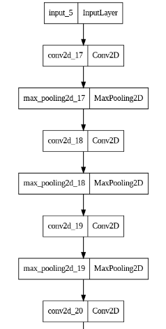
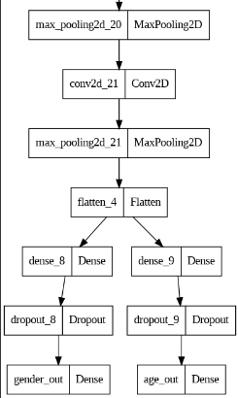
Model architecture
Model 5: Train for longer (Increase number of epochs)
Convolutional layer [16, 32, 64, 128, 256]
Kernel size [3 x 3]
Max - Pooling layer [2 x 2]
Flatten layer
Fully connected layer[256,512]
Dropout layer[0.3]
Activation layer[ReLU, sigmoid, Linear]
Evaluation function[“Binary cross entropy”, “MAE”]
Optimizer [Adam]
Accuracy Metrics

Slide 15
Model training
Loss Functions:
Gender Prediction: Uses Cross-Entropy Loss because it is effective for binary classification tasks.
Age Prediction: Uses Mean Absolute Error (MAE) because it measures the average magnitude of errors in a set of predictions, without considering their direction.
Optimizer:
Adam Optimizer: Chosen for its efficiency and adaptive learning rate capabilities. Adam is well-suited for large datasets and complex models.
Batch Size and Number of Epochs:
Batch Size: 32 (Small enough to allow frequent updates and large enough to maintain a stable gradient.)
Number of Epochs: 20 (Chosen based on the convergence of the training and validation losses, ensuring the model is trained sufficiently without overfitting.)
Data Split:
Training Data: 80%
Validation Data: 20%
The data is split to ensure that the model can be trained on a large portion of the data while being validated on a separate set to monitor its performance and avoid overfitting.

Slide 16
Model evaluation
Metrics for Assessment
Accuracy for Gender Prediction:
Definition: The ratio of correctly predicted instances to the total instances.
Formula: Accuracy=Number of Correct Predictions/Total Number of Predictions
Reason: Accuracy is straightforward and suitable for binary classification tasks like gender prediction.
Mean Absolute Error (MAE) for Age Prediction:
Definition: The average of the absolute differences between predicted ages and actual ages.
Formula: MAE=(∑i=(1 to n)​∣actual - predicted​∣)/n
Reason: MAE is used for regression tasks as it directly measures the prediction error in the same units as the target variable.

Slide 17
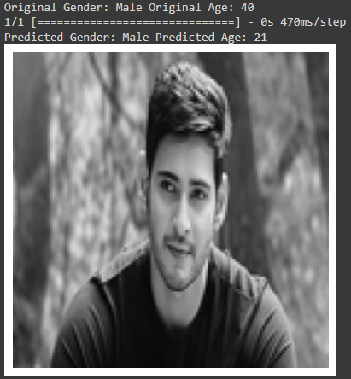
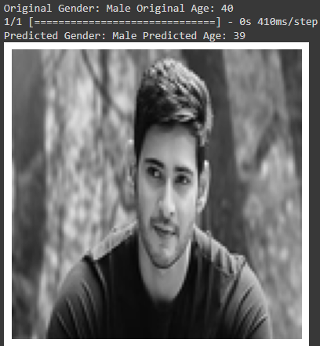
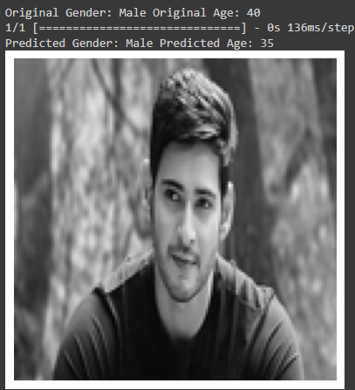
Result & Visualization
Model 1: Base Model Model 2: Increase Layers Model 3: Decrease layers

Slide 18

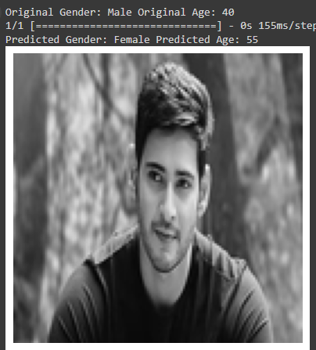
Result & Visualization
Model 4: Add learning rate Model 5: Train for longer

Slide 19
conclusion
The project successfully developed a Convolutional Neural Network (CNN) model to predict gender and estimate age from facial images.
The model demonstrated high accuracy in gender prediction and reasonable precision in age estimation.
Key takeaways include the importance of effective preprocessing in enhancing model performance.
Accurate gender and age prediction significantly enhances user experience through personalized content and targeted advertising, supports better business and research decisions, and contributes to security and content moderation.
The impact of such models extends to various real-world applications, including social media, marketing, healthcare, and public safety, highlighting the potential of CNNs in these areas.

Slide 20
references
[1] L. X. Z. N. L. Y. A. F. Liu W, Wang Z, A survey of deep neural network architectures and their applications. Neurocomputing, 2017. [Online]. Available: https://www.sciencedirect.com/science/article/abs/pii/S0925231216315533?via%3Dihub
[2] S. M. Tian H, Chen SC, “Evolutionary programming based deep learning feature selection and network construction for visual data classification,” 2020. [Online]. Available: https://link.springer.com/article/10.1007/s10796-020-10023-6
[3] Z. W. X. Wang, L. Liang and S. Hu, “Age estimation by facial images: a survey,” China Journal of Image and Graphics,” 2012. [Online]. Available: Wang: Age estimation by facial images: a survey - Google Scholar
[4] V. M. P. R. Ranjan and R. Chellappa, “Hyperface: a deep multi-task learning framework for face detection, landmark localization, pose estimation, and gender recognition,” no. 121-135, 2019. [Online]. Available: https: //ieeexplore.ieee.org/document/8170321
[5] U.-N. F. S. S. S. M. Hossain E, Khan I, “Application of big data and machine learning in smart grid, and associated security concerns: a review,” IEEE Access, 2019. [Online]. Available: https://ieeexplore.ieee.org/document/8625421/

Slide 21

THANK YOU
Nishita Bajaj
bajajnishita987@gmail.com

